Slide 1
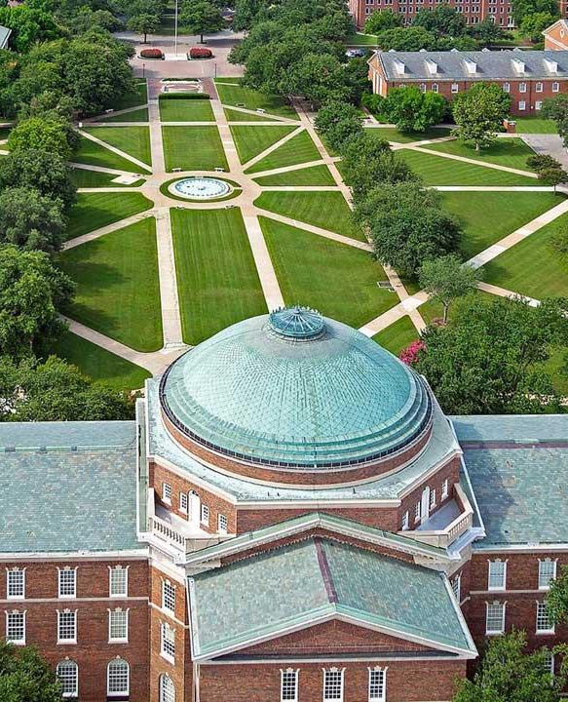
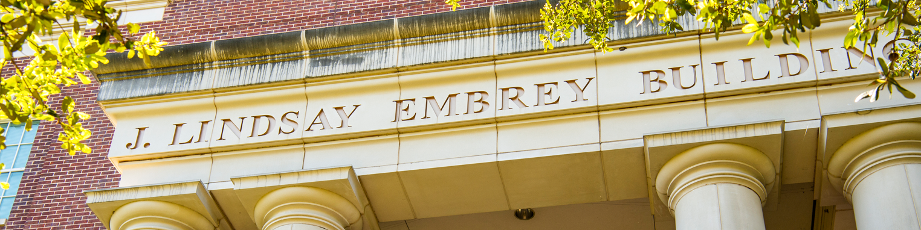
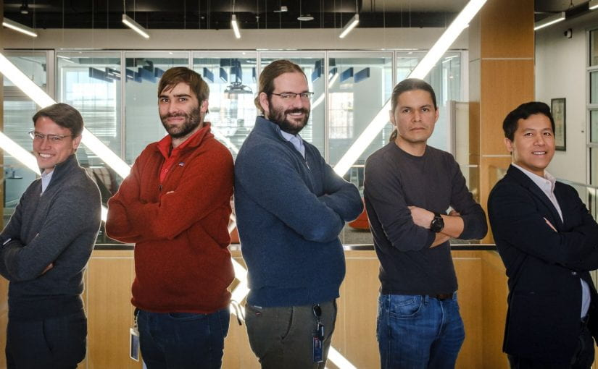
Introduction tue vu
To CEE Department - SMU
Research and Data Science Services

Slide 2
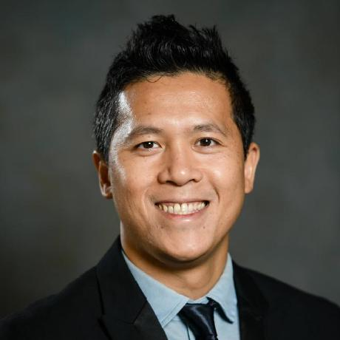
Education
Experience
2013
PhD: National University of Singapore
(Hydro-Climatology)
2021
AI/ML Research Scientist, OIT, SMU
2018
2021
Senior HPC Research Facilitator, Clemson Computing & Information Technology
Research Assistant Professor, Glenn Department of Civil Engineering, Clemson University
2007
MSc: Nanyang Technological University & Stanford University
(Environmental Engineering)
2015
2018
Postdoc at Glenn Department of Civil Engineering, Clemson University
TUE VU
AI/ML Research Scientist
Advanced Research & Data Science Service
Office of Information Technology
Email: tuev@smu.edu
Office: 119 Gerald Ford hall
2007
2015
Research Fellow, Tropical Marine Science Institute, National University of Singapore
Research
Teaching
Impact study of Natural Hazard (Flood & Drought)
Seasonal Forecast and Climate Prediction
AI/ML in weather & climate
Statistical & Stochastical modeling of rainfall
Geo-spatial analytics
Extreme value analysis
Research computing using HPC
Computer languages: Linux, R, Python, Matlab
Visualization: R, Python, Tableau
Machine Learning: scikit-learn, R-caret, Rapid Miner
Deep Learning with Keras using CNN, RNN
Master thesis co-supervisor for Euro-Aquae MSc students

Slide 3
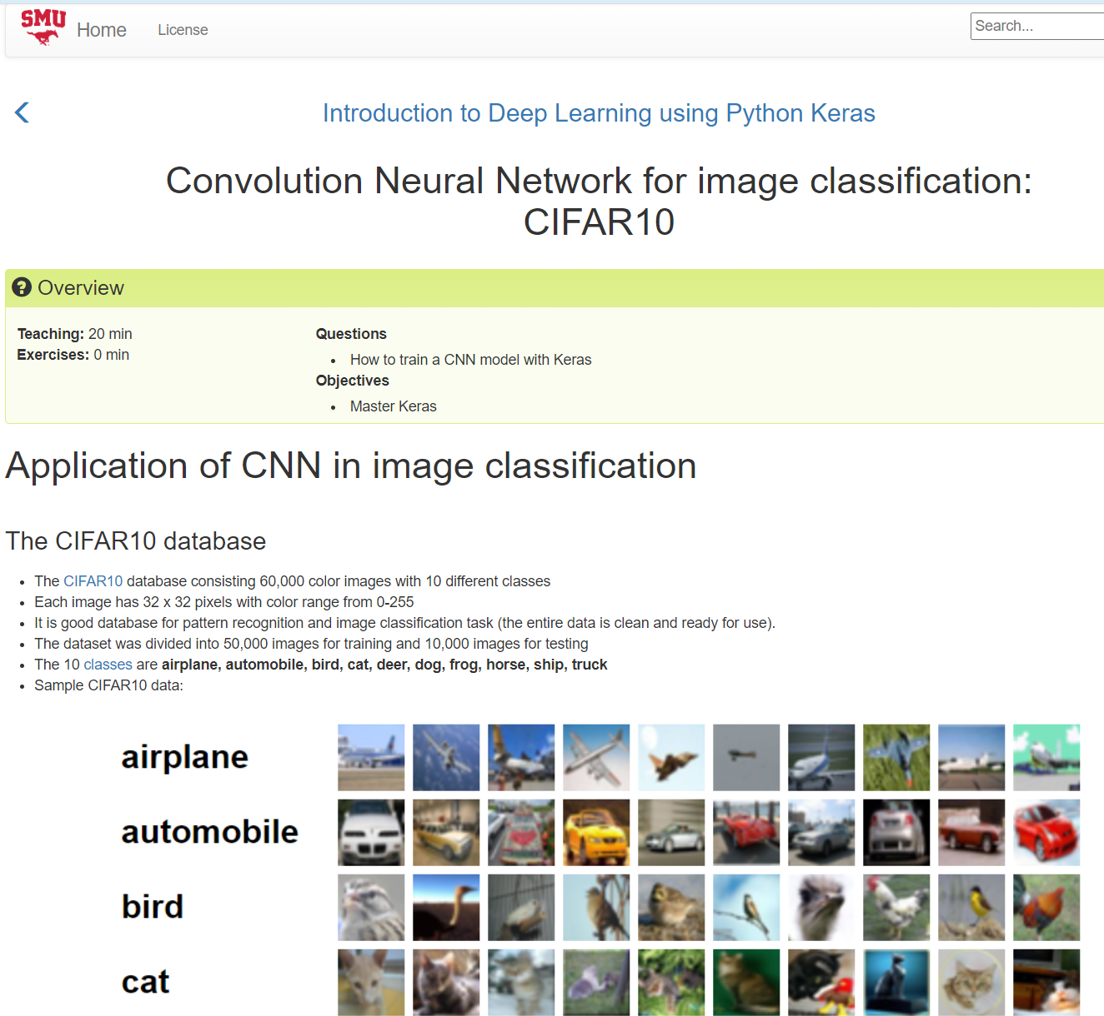











Education
Experience
2013
PhD: National University of Singapore
(Hydro-Climatology)
2021
AI/ML Research Scientist, OIT, SMU
2018
2021
Senior HPC Research Facilitator, Clemson Computing & Information Technology
Research Assistant Professor, Glenn Department of Civil Engineering, Clemson Uni
2007
MSc: Nanyang Technological University & Stanford University
(Environmental Engineering)
2015
2018
Postdoc at Glenn Department of Civil Engineering, Clemson University
TUE VU
AI/ML Research Scientist
Advanced Research & Data Science Service
Office of Information Technology
Email: tuev@smu.edu
Office: 119 Gerald Ford hall
2007
2015
Research Fellow, Tropical Marine Science Institute, National University of Singapore
Research
Teaching

Slide 4
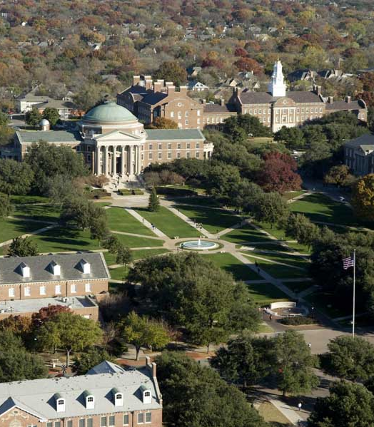
What is my role at SMU?
SMU OIT

Slide 5
What is my role at SMU?
Advance Research Support using AI/ML/HPC for all faculty and research staff/students, all SMU departments
Participating in the SMU overall effort to R1 universities
Promote the use of ManeFrame 2 and especially the upcoming SuperPOD – a new NVIDIA HPC equipped to SMU
Conduct workshop on AI/ML and advance research guidance with M2 and the new SuperPOD
Participate in Grant writing with focus on AI/ML/HPC
(Maintain high quality research with Department of CEE (journal and grant writing))
SMU OIT

Slide 6
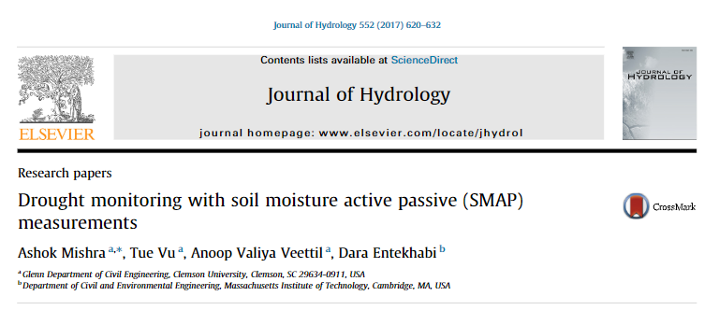
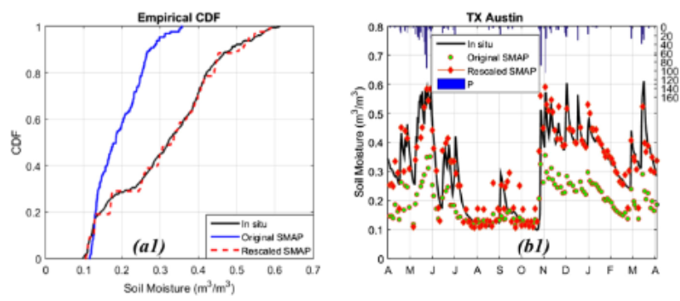
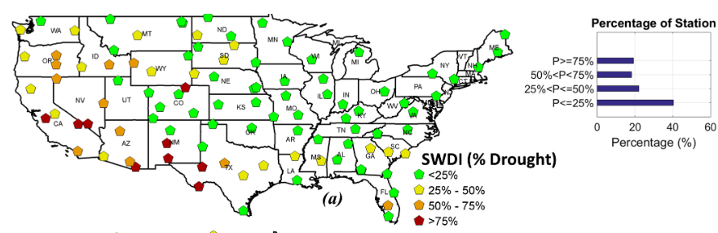
Typical research
Analyses the soil moisture variability from NASA Satellite images
Bias correct the satellite images with ground truth data using quantile mapping
Compute the drought indices for all CONUS stations
Indicate whether or not the soil moisture from NASA satellite is good for drought study

Slide 7

Grant writing
I participated in 2 grant proposals (All accepted) while working at Clemson University:
Determining the Postmortal Interval from survey data using Machine Learning approach – Funded by National Institute of Justice
COVID-19 and psychological health in the American South: Modeling impacts in low-income African American families using machine learning – Seed Grant funded by The Health Sciences Center (HSC) at Prisma Health

Slide 8
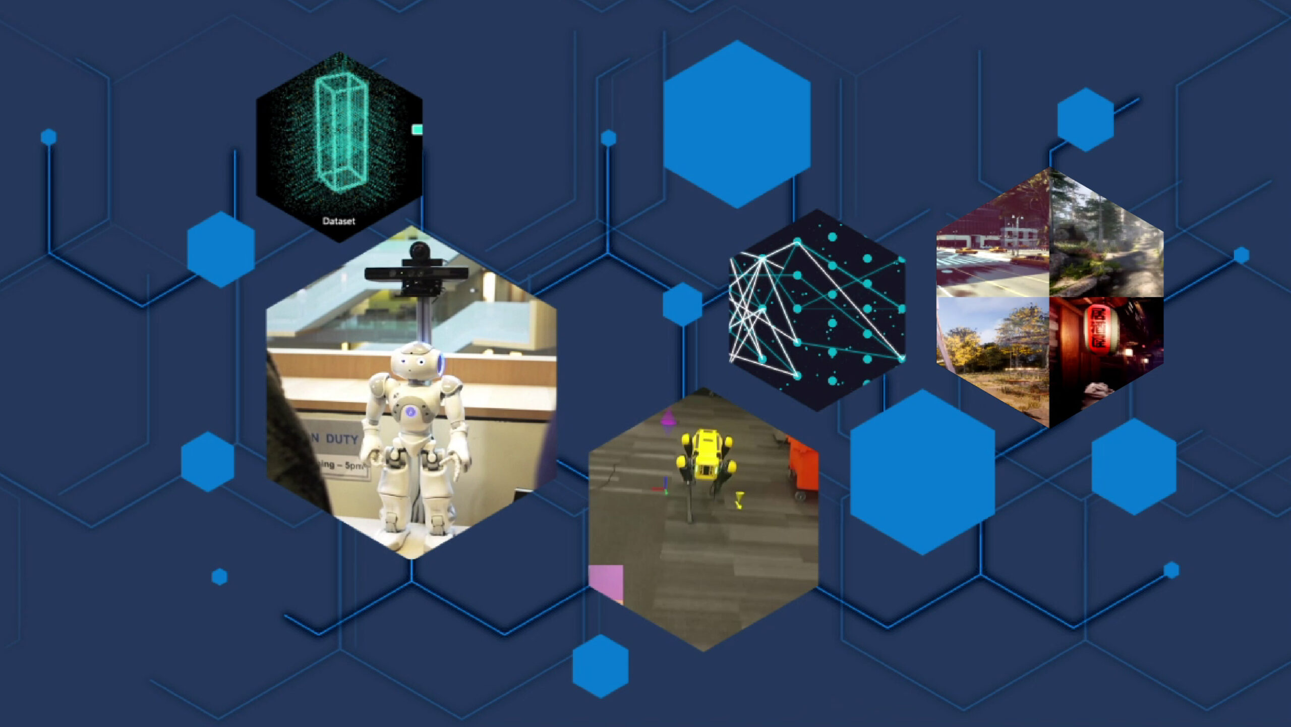
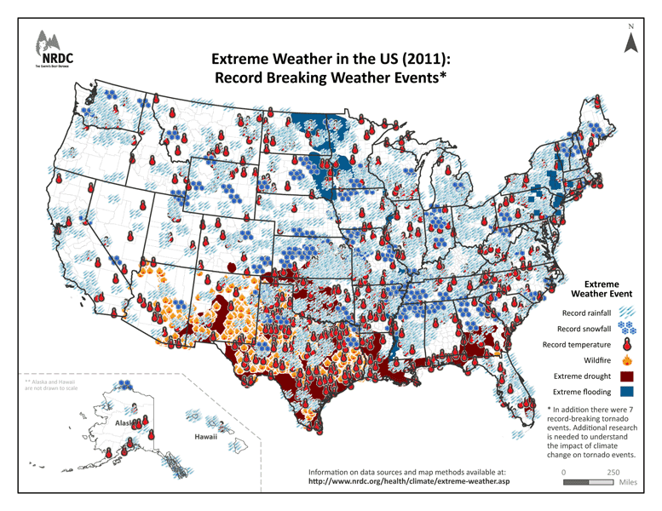
My future research
Beside participating with faculty on their own research I also want to conduct my independent research
The main topic I am following is application of AI/ML/DL in early warning/forecasting/predicting the natural hazard (flood/drought) for impact study (climate change, food security, evacuation) with big data and the use of HPC
SMU OIT

Slide 9
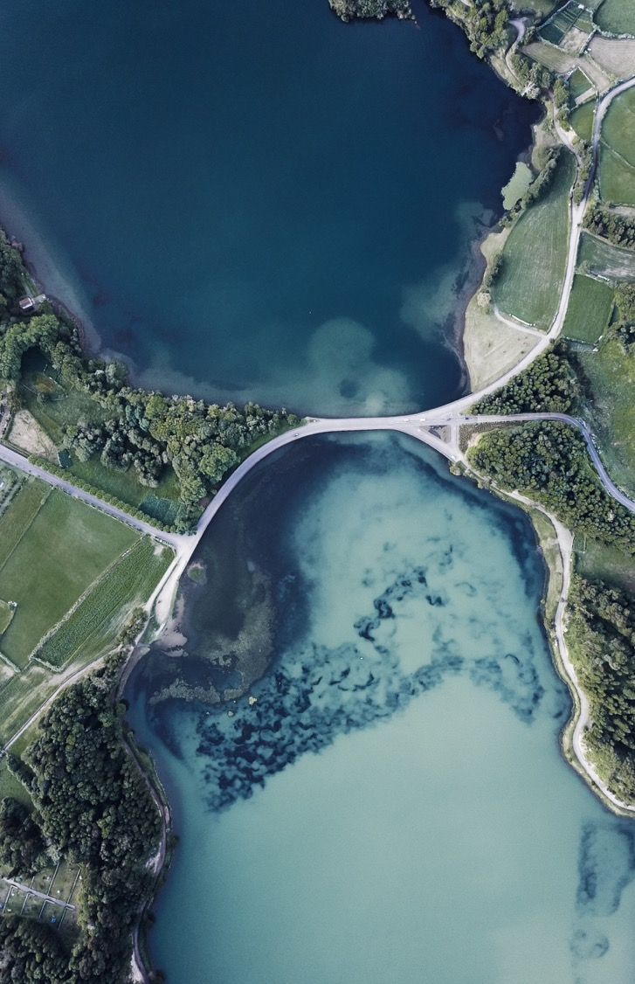
Thank You
tuev@smu.edu
https://www.smu.edu/OIT/Research/DataScience
https://scholar.google.com/citations?hl=en&user=IS9y7dEAAAAJ
https://www.linkedin.com/in/tue-vu/

Slide 10
Questions?

Slide 11
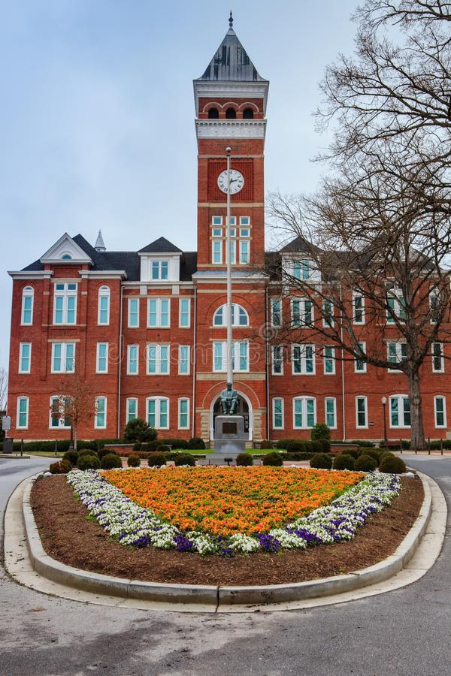
What WAs my role at CLEMSON?
Advance Research Support using HPC for all faculty and research staff/students, more than 60 departments, including several SC state’s universities
Conduct workshop on AI/ML/HPC to all faculty/research staff/graduate/undergraduate
Participate in Grant writing with all faculty with focus on AI/ML/HPC
Member of CU-Computation Advisory Team, to supervise the usage of Palmetto Clusters to all faculties
Develop and Maintain high research support levels and keep Clemson standing strong in R1 as well as Top500 HPC
Maintain high quality research with Glenn Department of Civil Engineering (journal and grant writing)

